Slide 1
Helen:
A complete & nice person
or
H.e.l.e.n. - K.L.R.
Hierarchical Event-learning Language and Network for Knowledge Representation

Slide 2
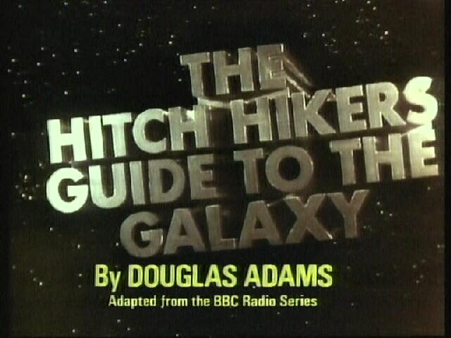
Finding the answer to life, the universe, and everything

Slide 3
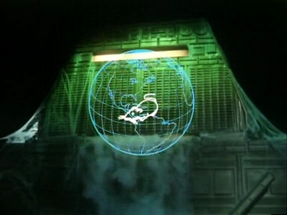
Deep Thought ..the 2nd greatest computer ever built
Vs.
The Great Hyberlobic Omni-Cognate Neutron Wrangler of Ciceronicus 12
Can talk all four Legs of an Arcturan Mega-Donkey.
But only I (Deep Thought) can convince it to go for a walk AFTERWARDS.

Slide 4
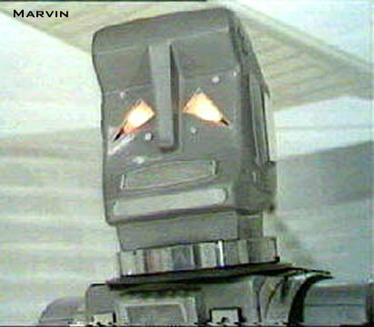
Feature- Brain the size of a planet Uses – Picking up trash, …..smartly

Slide 5
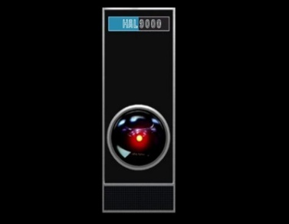
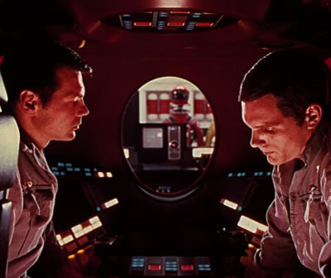
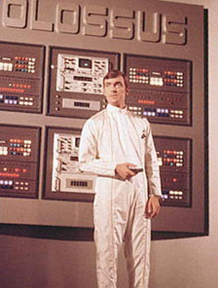
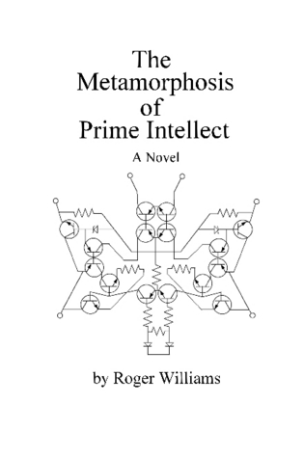
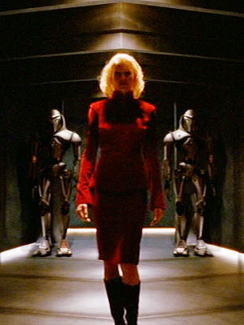
Tool( Actuator ) => Object Manipulator Tool( Language ) =>People Manipulator
Colossus Forbin Project
HAL 9000
2001: Space Oddessy
Cylon Six – “Skin Job” (not toaster)
Battlestar Galactica
Prime Intellect

Slide 6
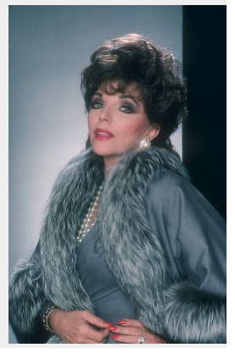
Intelligence Undefined
Subset of behaviors
Probably the highest skill set animal cognition has achieved so far.
Being able to: internally represent and manipulate its current situation
Alexis Carrington-Colby Socialite sets the standard??

Slide 7
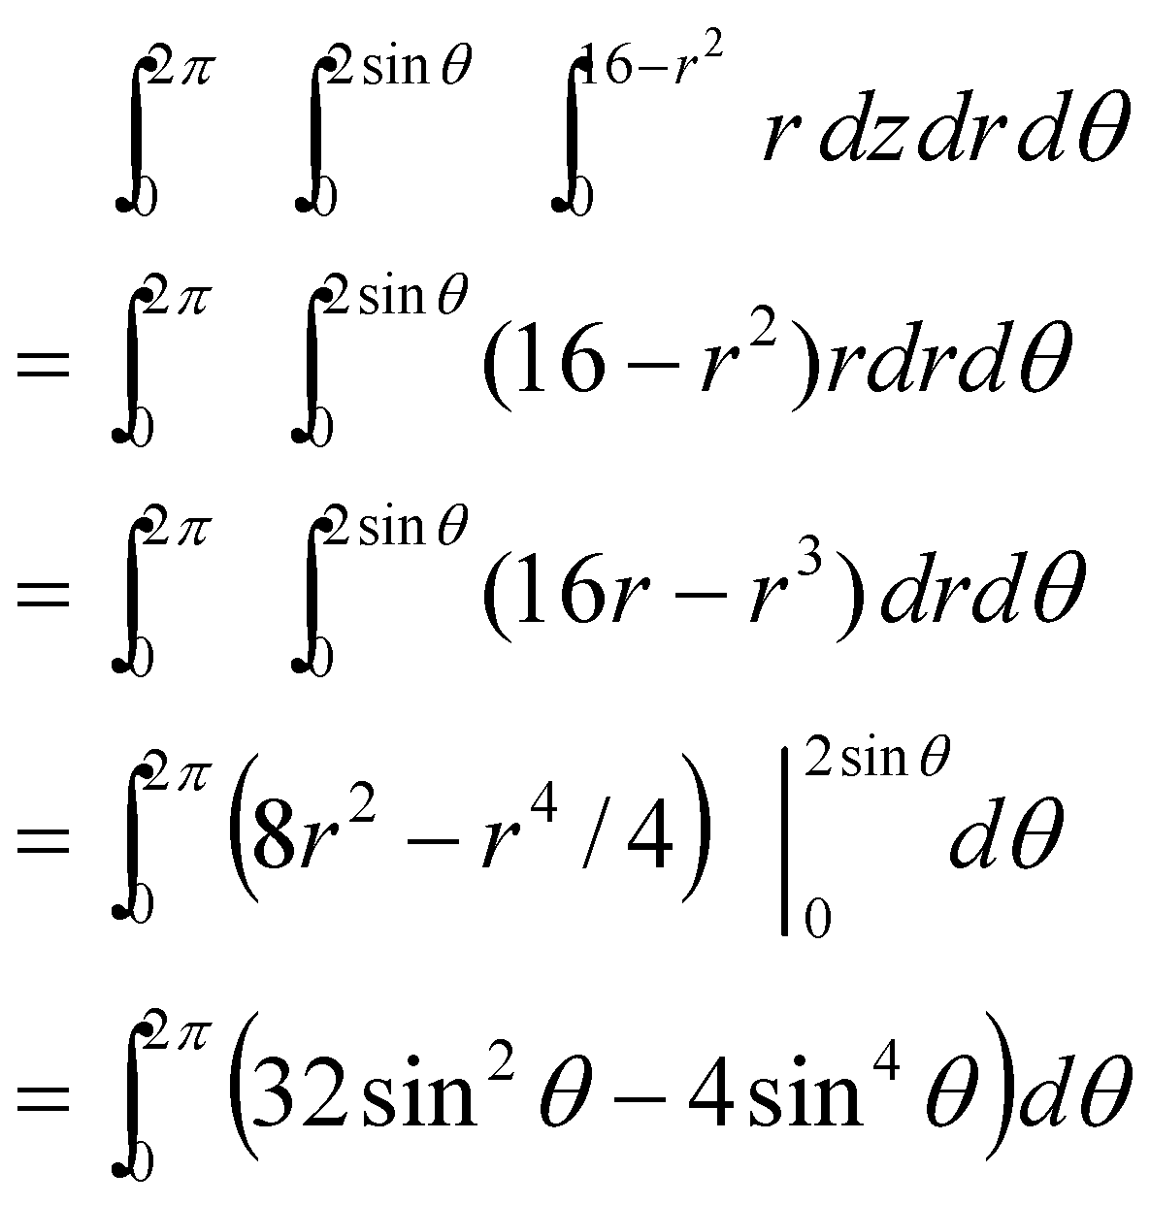
One Substrate can represent all things
Same Substrate used to internally represent and manipulate these two situational schemes and objects, roles, and feature content.
David Hasson and Ying Huang's
What actions is used to manipulate these objects? What value are they given?

Slide 8
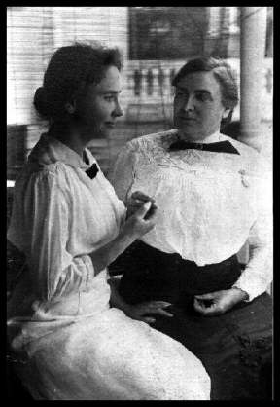
Helen Keller
Blind-Deaf at 1.6 years;
Learned /communicated by touch
Learned very high level concepts
Generated intricate language
Take away: feasibility of passing
a Turing test via brail (feeling dots
on a finger)

Slide 9
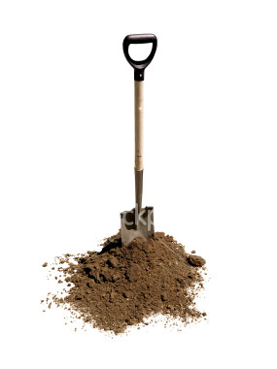
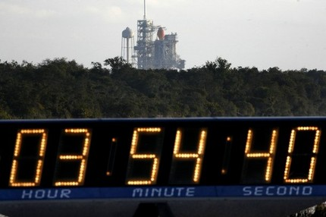
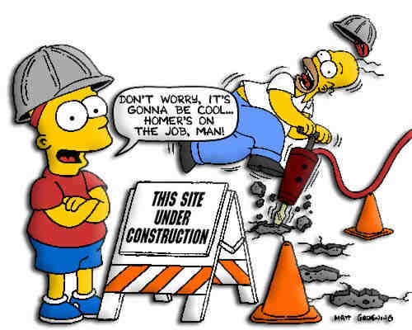
Under Construction
Rosie’s on the Job
Shovel Ready
for a small stimulus!

Slide 10
HELEN is an “all up system” for human behavior
Apollo 4 was build & tested as an all-up design

Slide 11
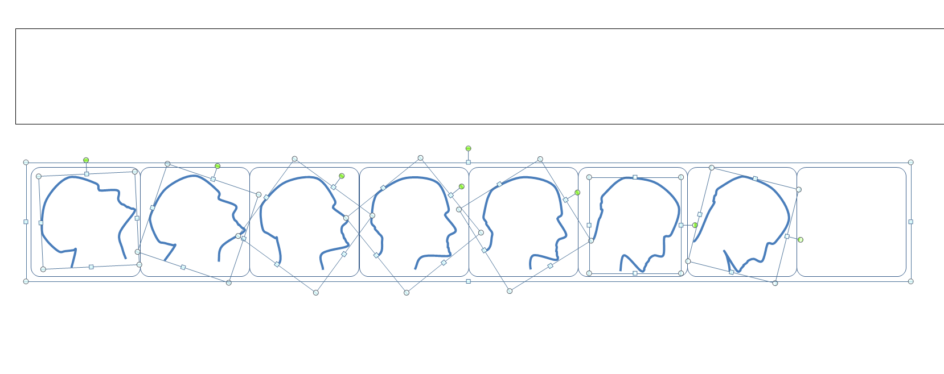
Heads up

Slide 12
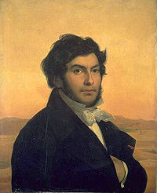
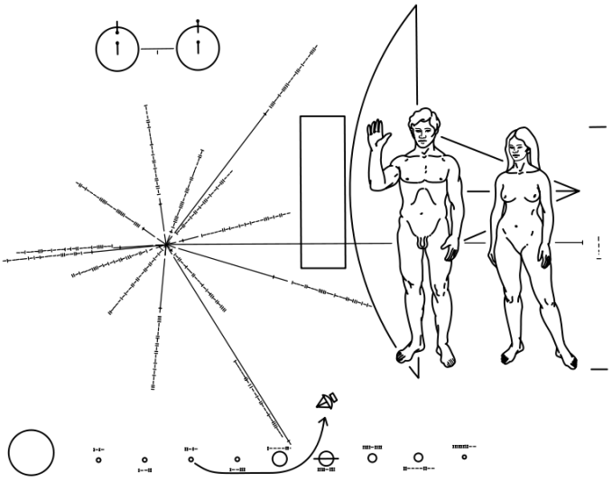
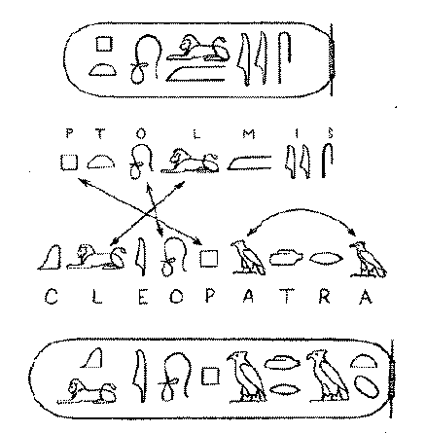
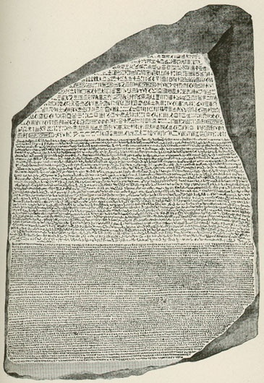
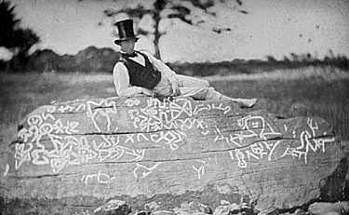
“Rosetta Stones” Approach
“”
Need to be grounded in the culture “behavior set” of the writer to give the correct meaning

Slide 13
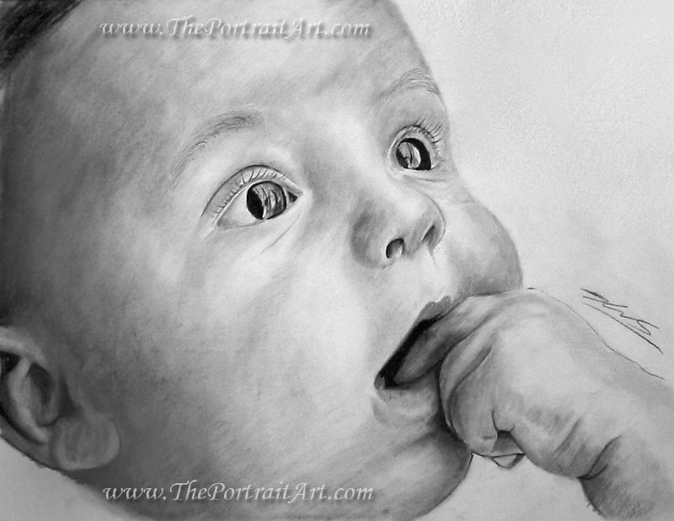
Language Understanding
Before you do language.. You have to get the system’s attention
Baby stare by ~theportraitart
http://theportraitart.deviantart.com/art/Baby-stare-109054707

Slide 14
Authority System
- Determines General Attention
- Determines what will be given meaning
Positive Valence (~Love)
Positive Valence (~Fear)

Slide 15
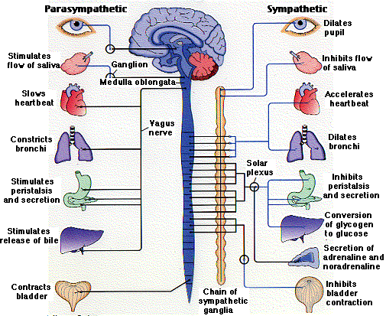
Toss in one of the more important and overlook mechanism!!
Mammals Use this to give Initial meaning

Slide 16
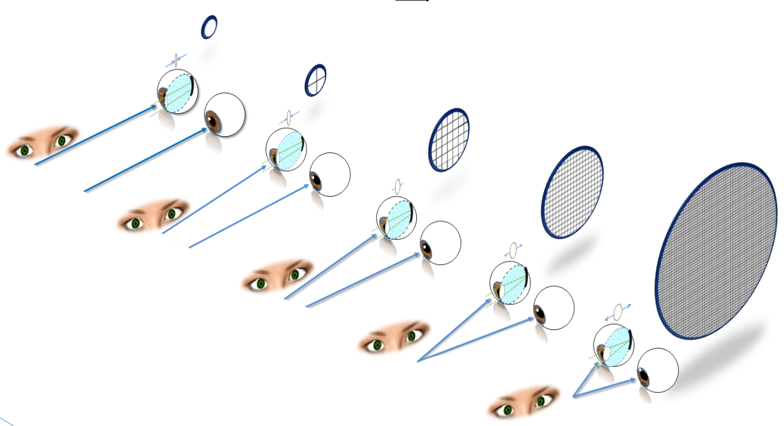
Throw in the relevant mechanisms and cycles we have
Cortical Magnification:
More detail in Lowest Focus level
Cognitive Cycles

Slide 17
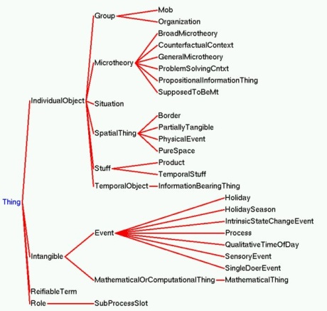
CyCorp Ontology Knowledge Representation

Slide 18
`

Slide 19
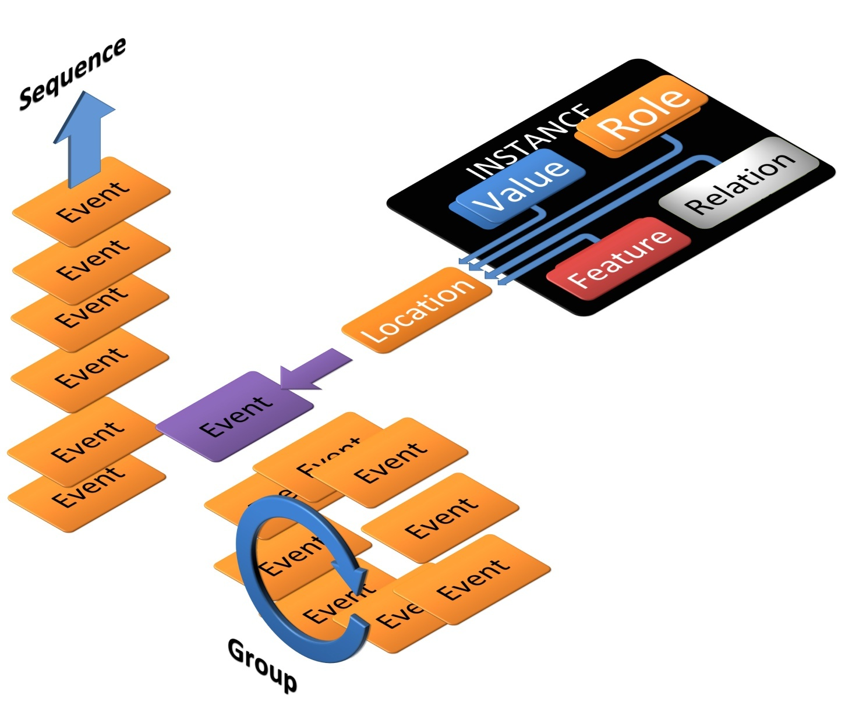
Directional and Group Storage of Situations

Slide 20
Cognitive Blending – moment to moment decides how and what meaning is given to situations

Slide 21
Some events are worth keeping… memories are biased towards our higher rewards

Slide 22
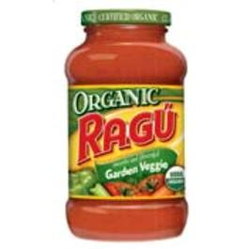
Like Rague …it’s in there

Slide 23
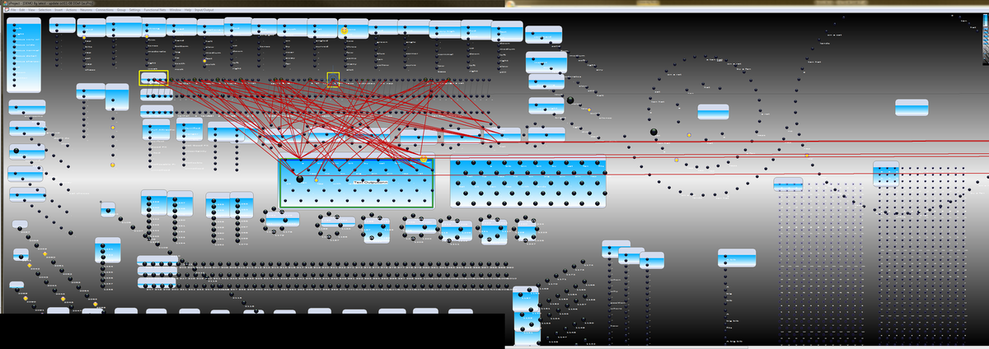
So what’s HELEN’s Thinking

Slide 24
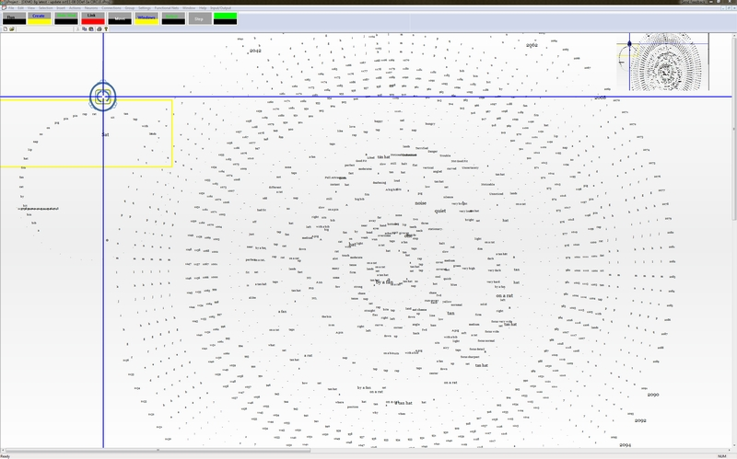

Slide 25
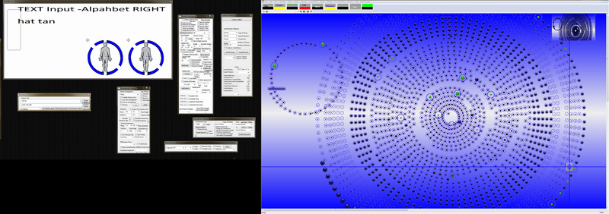
How does her body feel?
..er, that is how she feels about her body

Slide 26
So how does HELEN “do” Language??

Slide 27
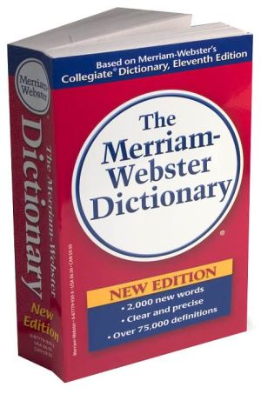
First, throw away the dictionary and grammar books

Slide 28
Babies (all humans) copy whole situations including intonation and all noticed body positions (mirroring the input)

Slide 29
There are only situational representation
Situation ( Situation Situation)
(Situation Situation) Situation)
Situation (Situation) Situation…
…
Can handle any order (any language)
Subject Object Verb
Subject Verb Object
Object Subject Verb

Slide 30
Sentence is not the primary unit of language communication.
Attention (focus) is the unit.
(Situation Situation) Situation Situation

Slide 31
Meaning can be given on the fly where it does not fit perfectly (normal)
Change meaning by moving and sizing attention and focus-depth.
(Situation Situation) Situation Situation
e.g. put it in a different situation (context)

Slide 32
The relation is innately tract
Temporal and Sequential structure influences attention and meaning that we give situations
Situation Situation Situation Situation situation
Situation Situation
e.g. is the pace of emotional content building from situation to situation? Is it choppy or continuous?

Slide 33
Parts of Speech?? …Humans innately uses “parts of brain”.
Point of view
Attention Region
Focus Detail
Acknowledgement (Affrim)
End-Stopping (situation start/end)
Instance

Slide 34
HELEN
Given Childhood experience as situational memories
Story Understander – Game Player (human innate)
Dialogue (human innate)
Very fast reader (had good parents)
Gives internal subjective meaning to situations
Metaphor/Analogy
Read Entire Novels, Textbooks

Slide 35
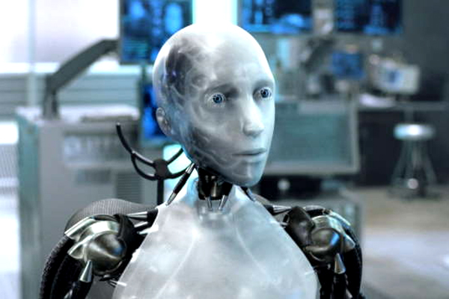
NS-5 Sonny had no comment about HELEN … at this time.

