Slide 1
Economic Attention Networks:
Associative Memory and Resource Allocation for General Intelligence
Matthew Iklé, Joel Pitt, Ben Goertzel, George Sellman
Adams State College (ASC), Singularity Institute for AI (SIAI), Novamente LLC,

Slide 2
EConomic Attention NetworkS
Resource Allocation
Associative Memory
Part of OpenCog or standalone
Nonlinear dynamical system
Engineered for behavioral outcomes, not intended as a neural model

Slide 3
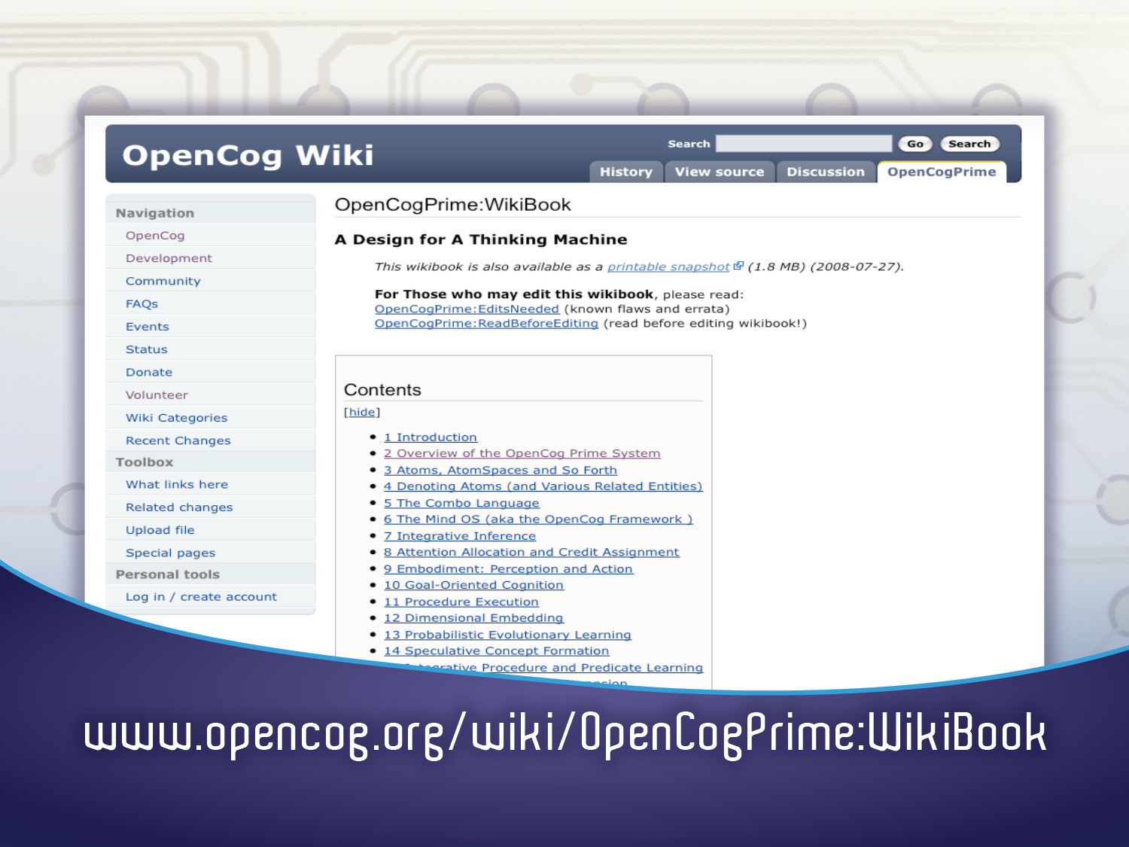

Slide 4
Declarative Memory
Cognitive Processes Associated with Types of Memory
Sensorimotor Memory
Uncertain Inference:
deduction, induction,
abduction, etc.
Unsupervised Pattern Mining
Concept creation:
Including blending
Modality specific memory :
Body map for haptics & kinesthetics,
hierarchical memory for vision, etc..
Specialized pattern recognition:
Creates patterns linking modality-specific
stores into declarative, procedural and episodic
memory
Attentional Memory
& System Control
Dynamic attention allocation:
Dynamically determining the space and time resources allocated to memory items,
for resource allocation & credit assignment
Map formation
Identification and reification of global emergent memory patterns
Goal System
Refinement of given goals into subgoals; allocation of resources among goals
Procedural Memory
Episodic Memory
Internal Simulation
of historical and hypothetical
external events
Spacetime interface:
special mechanisms for linking
spatiotemporal experiential knowledge
with delcarative and procedural knowlege
Supervised program learning
Learning of a program given a
“fitness function”
Deliberative planning
Done in an uncertainty-savvy way

Slide 5
Sensorimotor Memory
(modality-specific data tables, linked into weighted labeled hypergraph)
Declarative Memory
(weighted labeled hypergraph)
OpenCogPrime Cognitive Processes
Probabilistic Logic Networks:
deduction, induction,
abduction, etc.
MOSES:
Creative pattern mining
Concept creation:
evolutionary, blending, logical,…
Modality specific tables:
Body map for haptics & kinesthetics,
octree for vision, etc.
Specialized pattern recognition:
Creates patterns linking tables into
declarative, procedural and episodic
memory
Attentional Memory
& System Control
Economic attention allocation:
Dynamically updating short and long term importance values of memory items,
for resource allocation & credit assignment
Map formation
Identification and reification of global emergent memory patterns
Goal System
Refinement of given goals into subgoals; economic AA to allocate resources among goals
Procedural Memory
(hierarchically normalized LISP-like program trees)
Episodic Memory
(space-time indexed hypergraph nodes, used to trigger 3D movies in internal simulation world)
Internal Simulation World:
Virtual world engine
without visualization component
Spacetime algebra:
Special algebraic
system of spacetime predicates
MOSES:
Probabilistic evolutionary
program learning.
PLN
Deliberative planning
Occam-guided hillclimbing:
More rapid learning
of simpler procedures

Slide 6
The OpenCog hypergraph knowledge representation bridges the gap between subsymbolic (neural net) and symbolic (logic / semantic net) representations, achieving the advantages of both, and synergies resulting from their combination.

Slide 7
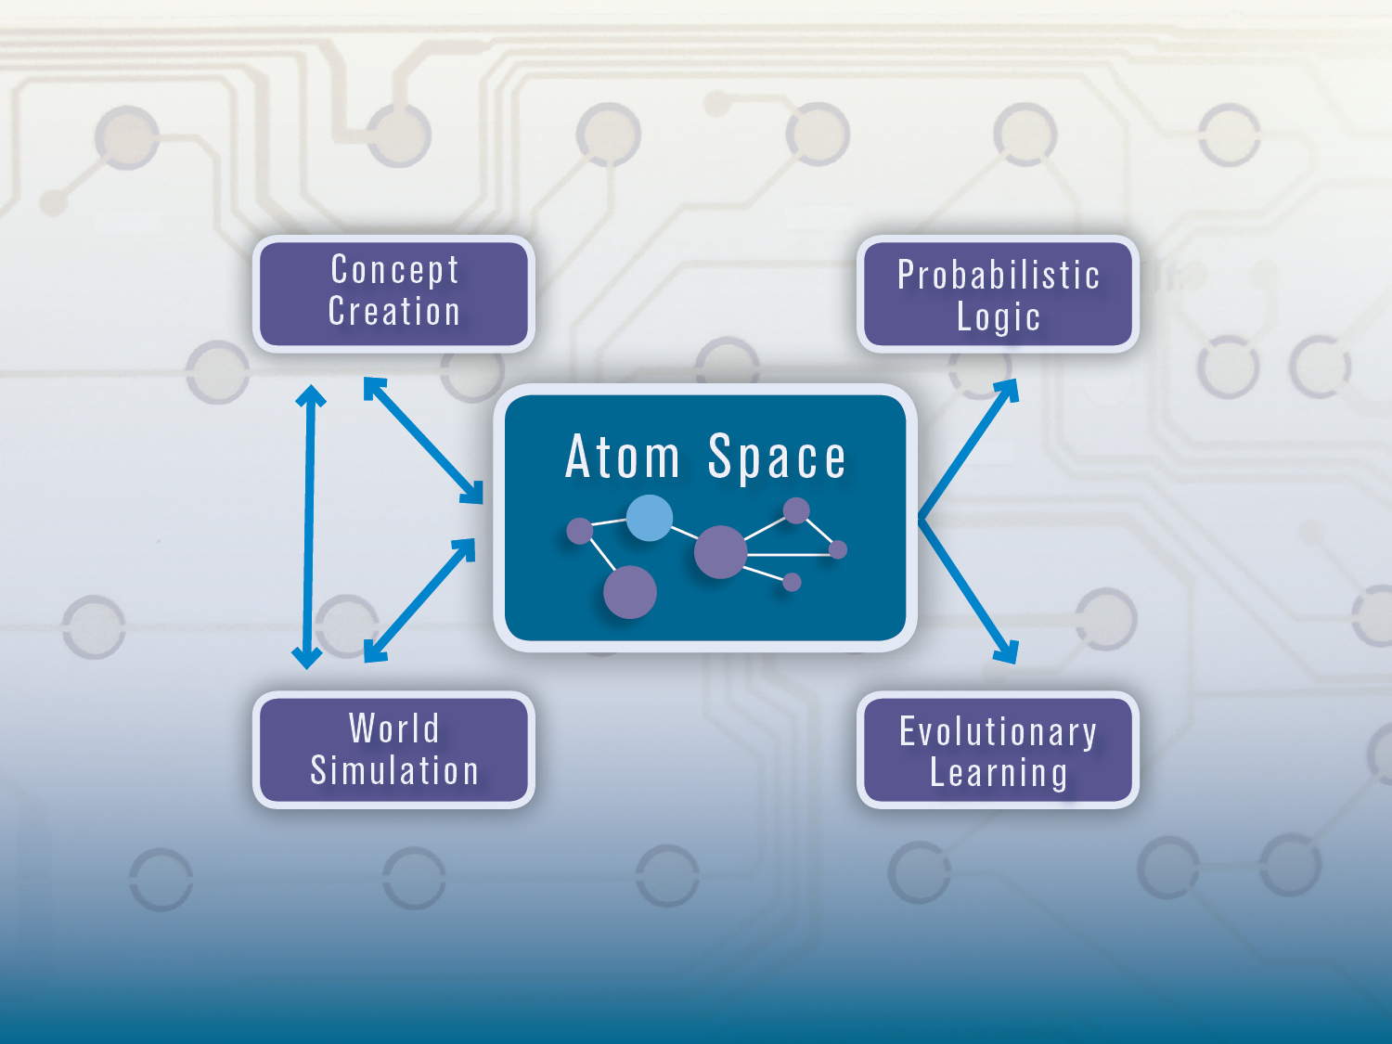

Slide 8
ECAN Network Structure
ECANS are graphs
Links and nodes are called Atoms
  nodes and links without type, or without ECAN-relevant type
  HebbianLink
  InverseHebbianLink
Atoms weighted with two numbers:
  STI (short-term importance)
  LTI (long-term importance)
Hebbian and InverseHebbian link weighted with probability values
Hebbian and InverseHebbian links mutually exclusive

Slide 9
Short-term and Long-term Importance (STI and LTI)
artificial currencies
conserved quantities (except for unusual circumstances – e.g. Economic Stimulus Package)
STI: the immediate urgency of an Atom
LTI: measure of importance for quick recall of Atom
Forgetting process: uses low-LTI and other factors to remove Atoms from quick memory

Slide 10
The Attentional Focus (AF)
Atoms with highest STI values
Associated with modified STI update equations
Probability value of HebbianLink from A to B = odds that if A is in the AF, then so is B
Probability value of InverseHebbianLink from A to B = odds that if A is in the AF, then B is not
FocusBoundary determined by Decision Function (Threshold or Stochastic)

Slide 11
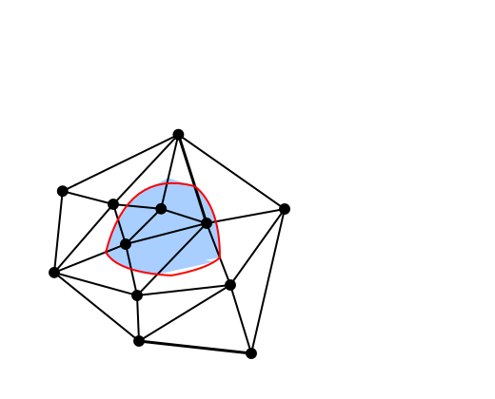
The Economic Model: Wages and Rent
Central Bank
(CogServer)
Stimulus and Wages
Rent
Network
Notes:
nodes receive wages and pay rent
positively correlated to a node’s STI
Rent is determined by a cue pattern
Ignoring irrelevant atoms

Slide 12
ECAN Dynamics: AF Formation
STI spreads to other Atoms via Hebbian and InverseHebbianLinks
Uses a diffusion matrix (normalized connection matrix)
analogue of activation spreading in neural networks
can be viewed as STI “trading”
Automatically pulls nodes in and out of AF

Slide 13
ECAN Dynamics: Graph Updating
Changing STI values causes changes to the Connection matrix
Memory Formation and Recall

Slide 14
Applying ECAN to Associative Memory
Two Key Behaviors
  Stimulus → Memory Formation
  Stimulus → Relevant Memory Recall

Slide 15
Applying ECAN to Associative Memory
Two Key Behaviors
  Stimulus → Attentional Focus →Memory Formation
  Stimulus → Attentional Focus →Relevant Memory Recall

Slide 16
Testing Associative Memory Functionality
Train by imprinting sequence of binary patterns
Noisy versions used as cues for retrieval
converges to an attractor

Slide 17
Conclusions
Dramatically different dynamics than standard attractor neural nets
Superior memory formation and recall
Serves to effectively allocate resources
Enables straightforward integration with additional cognitive processes (e.g. PLN inference)

