Slide 1
Extending Cognitive Architectures with Mental Imagery
Scott Lathrop
John Laird
AGI-09
Notes:
Intro
- Good _________. I am Scott Lathrop. In this talk I will discuss our effort to extend cognitive architectures by adding functionality inherent to a human’s mental imagery processing. Specifically I am focused on how to incorporate spatial and visual imagery mechanisms so that the architecture can better support problem-solving in tasks that are rich with spatial and visual properties.
- Acknowledgements

Slide 2
WHY MENTAL IMAGERY?
Cognitive Architectures
Amodal, symbolic representations & computations
No general reasoning with perceptual-based representations (Barsalou 1999, 2008)
Resulting in…
Ad-hoc reasoning in tasks rich with spatial and visual properties
“Bolted-on” task-dependent components
What we desire…
“Best of both worlds” multi-representational, task-independent approach
Functionality
Computational advantage
Link perceptual-based thought and cognition
Notes:
Transition: So the first question we must answer is why should we research mental imagery in the context of a cognitive architecture where a cognitive architecture consists of the fixed computational mechanisms necessary for achieving general intelligence? Knowledge representation and reasoning in these systems have traditionally focused on amodal, symbolic computations—and this is true for Artificial Intelligence in general. These representations include semantic networks, production systems (such as what you see in Soar or ACT-R), or Bayesian networks. These symbolic representations may include metric information for control or for sensor input but they are not directly involved with thinking. Very few AI systems and until now no cognitive architectures have previously incorporated a visual depictive representation for the purpose of reasoning. These symbolic forms of knowledge R&R have proven useful for modeling human behavior and real world applications such as simulation entities and robotics.
The problem with this approach, however, is that we know that many people, to include scientists, engineers, and leaders, are very spatially and visual oriented—that is their decision-making proceeds by visualizing situations and reasoning over them. Cognitive architectures currently do not capture this capability and assume that perceptual-based representations are “thrown away” after sensory input is transduced to a symbol.
This results in ad-hoc reasoning in tasks rich with spatial and visual properties where
spatial properties include both spatial properties of an object (width, height, etc) and spatial relationships such as direction, distance, orientation, and topology between objects
and
visual properties are in addition to the spatial properties also arbitrary shape and color
“Bolted on components” – Examples in both Soar (Wray et. al.) and ACT-R (Best, Trafton)
What we really want is a cohesive theory and resulting architecture that intertwines perceptual-based thought and cognition (rather than simply plugging them together) by taking a “best of both worlds” multi-representational approach.
Where the system uses the representation that either provides more functionality or computational efficiency in tasks (at least in our case) that are rich in spatial and visual features.

Slide 3
MENTAL IMAGERY REPRESENTATIONS
Representation | Processing | Uses | Example
Symbolic Amodal | Symbolic manipulation | General Reasoning/Control Qualitative Spatial & Visual Reasoning | feature (letter-B, line) color(letter-B, blue) feature(box, corner) color(box, yellow) on(letter-B, box)
Quantitative spatial Amodal/Perceptual-based (Spatial Imagery) | Mathematical manipulation Dynamical Systems (motion models) | Spatial Reasoning (Generic Shapes) Facilitate building visual depictive representation | letter-B location <2,3,-2> orient 0 length 2 height 4 box location <0,0,0> orient 20 length 6 height 4 width 2
Visual depictive Modality-specific/Perceptual-based (Visual Imagery) | Mathematical manipulation Depictive manipulation | Spatial Reasoning (Specific Shapes) Visual Feature Recognition
Notes:
Transition: I argue that imagery processing uses at least three multiple representations for spatial and visual imagery (point out) which I am describing from a functional and computational standpoint rather than what is actually occurring at the neural level.
Visual depictive is a depictive representation where space in representation implies space in the world.
Symbolic
- Amodal, stable medium useful for general reasoning
- Symbols may denote an object, visual properties of that object, and spatial relationships between objects (point out examples)
- Power comes from composability using universal and existential quantification, conjunction, disjunction, negation, and other predicate symbols.
- In addition to visual and spatial properties, symbols can represent non-visual or non-spatial content, which is necessary for associating an object with other modalities and abstract concepts.
- Usefulness: for general reasoning and can be augmented with non-visual content which is necessary for associating with other modalities. In similar fashion as Marr proposed bottom-up visual processing to move from a concrete (raw primal sketch) to a more abstract representation, imagery processing works in a similar fashion but from a top-down perspective (abstract to symbolic). The symbolic representation facilitates building the quantitative spatial representation by including references to an object’s underlying shape representation and maintaining local spatial relationships between objects.
However, with this general descriptive representation there is an information void when a task requires more specific visual or spatial information to aid in reasoning/problem solving (i.e. width of box, relationship between box center and can center, whether can has a circle, if box is a darker green compared to a pine tree)
Quantitative Spatial
- Amodal, Perceptual-based (an interpretation of visual, auditory, proprioception, and kinesthesis senses based on a fixed frame of reference that asserts an object’s location and orientation in space)
- Frame of reference can be relative to an agent’s viewpoint (egocentric) or another object (allocentric).
- Computationally, the structure uses metric scalar values and vectors in a three-dimensional Euclidean space to represent information (illustrate with example
- Symbols label the objects.
- The processes that infer information from this structure use sentential, mathematical equations
- Composable: Can combine objects to form new objects but must commit to a location and orientation in space. Cannot represent disjunction, conjunction, etc.
- Uses: spatial reasoning (direction, distance, orientation, size, general topology) when an objects general shape is sufficient; Again facilitates building visual depictive representation by fixing objects location, orientation, size in space.
(Forbus poverty conjecture – lack of general qualitative representation for SR); (2) IR for depictive representation. Cannot move directly from abstract symbols to depictive representation without specifying where objects are located in space, their orientation, and relative size.
Visual Depictive
- Space, including empty space, and color are inherent in the visual depictive representation.
- The depiction is from a privileged viewpoint, and the spatial structure of the patterns resembles the objects in a perceived or imagine scene
- Computationally, it is an image data structure where the processing uses either mathematical manipulations (e.g. filters, rotation, and scaling) or algorithms that take advantage of the topological structure and color of the representation (illustrate with example).
- Usefuleness: For extracting an object’s visual features (e.g. lines, curves, enclosed spaces, corners) or for spatial reasoning where non-convex shapes are inherent to the problem

Slide 4
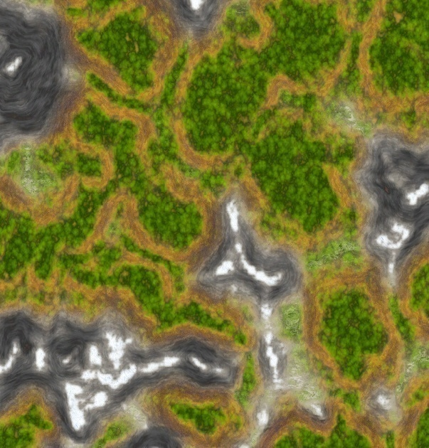
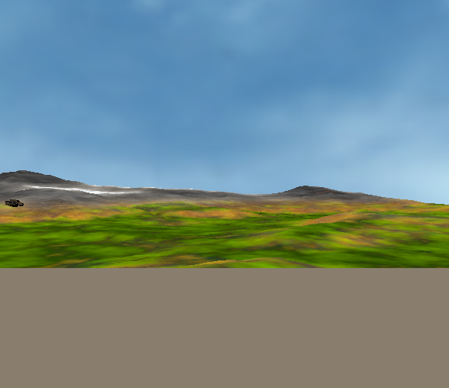
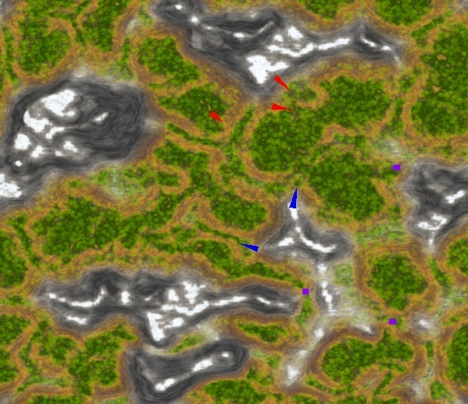
SCOUT DOMAIN
Enemy
Scout-2
Enemy Scout-1
Enemy
Scout-3
Enemy
Scout-1
Scout-2
(Teammate)
Scout-1
(Agent)
Scout-2
(Teammate)
Actual Situation
Teammate’s View
Observed
Enemy
Scout-2
Observed
Enemy
Scout-2
Hypothesized
Enemy
Scout
Hypothesized
Enemy
Scout
“Key”
Terrain
Scout-1
(Agent)
Agent’s View
Imagined Situation
Notes:
Transition: So as a motivating example, let me one of the domains we used to evaluate the architecture
Orient audience to Map (N,S,E,W). Topographical map Roads, woods, Mountains
Provide additional “big picture” knowledge. I.E. Scouts providing early warning for a main body, enemy recon units attempting to locate friendly reconnaissance elements and main body.
Observe
Agent sees things
Teammate sees things and reports; report is delayed
Analyzing the situation
Known friendly and known/hypothesized enemy locations and orientations, terrain, and obstacles.
Possible Enemy Avenues of Approach (Paths)
Friendly Coverage of those paths
Based on the analysis the scout leader then decides if he should reorient himself, his teammate, or both.
Decide/Act
Assumptions
Percepts
- Agent/Teammate can recognize objects (e.g. enemy tank, building) and distinguish between entities (the two enemy tanks I see are different)
- However, does not know if a tank the teammate reports is the same or a different tank from what the agent sees (has to infer this based on location)
- Messages from teammate contain accurate location and orientation information but are not up to date at that moment (there is a time lag). Agent must infer
Actions
- Are deterministic but not instantaneous (require some simulation time to occur)
- May be interrupted (e.g. if agent asks teammate to reorient to a certain orientation it will, but will not always make it to that orientation as it may be interrupted (e.g. sees an enemy while re-orienting).
- Enemy’s movement is random based on a few pre-planned (scripted) routes
For example… (go through the rest of the slides)

Slide 5
SCOUT DOMAIN

Slide 6
ARCHITECTURE

Slide 7
TASK OPERATORS
Symbolic (Procedural) LTM
IMAGERY OPERATORS
Symbolic STM
Construct
Generate
Soar
Goals
Current State
Transform
Inspect
SVI
Manipulator
Constructor
Visual-Spatial STM
Perceptual LTM
Feature
Set
Object
Set
Spatial
Set
Object Map STM
Shape
Texture
Spatial configuration
ObjA,ObjB,…
Quantitative spatial
Scene-graph
Viewpoint
Feature
Set
Object
Set
Spatial
Set
ObjA1,ObjA2,…
“What” Inspectors
“Where” Inspectors
Visual Buffer STM
Symbols
Visual depictive
Set of 2D bitmaps
Memory
Visual Symbols
Refresher
Process
Productions
“Rendered” Image
Stimulus-Based
Refresh
Control
Path
Data
Path
Notes:
Be clear to indicate what is in your “architecture” and what is theory / experimental evidence
Clarify that the image/pixels and scene graph/vectors is the functional and computational mechanisms you are using and not what people necessarily use.
Describe high-level Soar
SVI – Visual Imagery relies on mechanisms provided by vision, so I will start by first describing how high-level vision works from the bottom-up and then discuss how imagery operates using those shared mechanisms.
Outline Legend
Why Refresher – I will explain when I get to imagery, but in general, there has to be a mechanism that is in place that inhibits visual input from the environment when creating a top-down image from visual imagery.
Ventral Path – “What” inspector
Dorsal Path – “Where” inspector
The theory up to the VisualLTM and ObjectMap STM is pretty clear. From that point forward it gets pretty fuzzy. What I propose are that there are listeners or monitors that are summarizing or consolidating these memories and compacting them into a more abstract descriptive format.
Is visual imagery part of central cognition? 2 reasons
1) Intimately tied to vision. Want ability to share mechanisms with a vision system.
2) bi-modal; Imagery is quantitative and depictive. Not prepared to modify Soar’s working memory, procedural memory, episodic, and semantic at this time. It would require a major rethink
Temporal constraints for retention
Visual Buffer : 1-2 s
Object map 1- 10 s
Visual LTM: ?? Based on usage.

Slide 8
DEPICTIVE MANIPULATIONS (1 of 2)
Pixel-level rewrites (Furnas, 2000)
Production-like rules (LHS/RHS)
Shared image (i.e. working memory)
LHS and RHS are pixel patterns
Conflict resolution scheme (sequencing)
Processing may match other orientations
Active manipulation of shapes
Contrast with other image processing
Computer vision
Sentential manipulations
Filters (e.g. Gaussian) where each pixel is rewritten as a specific function of its neighbors’ values
Cellular Automata
Finite State Machines
Next state of a cell based on current state and state of its neighbors
Rather than rewriting many local configurations at once
“2x2 reduce”
= “don’t care”
“nibble
up”
“nibble left”
Notes:
Transition: One of the goals for the architecture in this domain was to expand on how the agent manipulates the visual depictive representation.
Each individual rule is simple (similar to production rules in Soar) but when you put them all together they can produce complicated behavior and reasoning
Comparison with Computer Vision (sentential-based algorithms)
- Computer vision uses pixel operations extensively in the early stages of preprocessing and parsing.
- Filters (e.g. Gaussian filters) highlight edges by enhancing brightness gradients in the pixel array.
- At later stages, computer vision parses shapes by tracing, pixel by pixel, the topologically connected components in the pixel array
- Most of the image processing operations are filters where each pixel is rewritten as a specific function of its neighbors’ values
- Pixel rewrites are sensitive to the pixel pattern in their local application so are less restrictive (the value of a pixel in that neighborhood changes not based on the value of its neighbors but rather based on the RHS pattern).
Comparison with Cellular Automata
Similarities
Grid representation of states which change over time as a result of simple “rules”
Differences
Cellular Automata “rules” are implemented as Finite State Machines that change the state of each cell based on its current state and that of its neighbors.
Pixel-level rewrite rules rewrite local configurations of cells at once based on pattern matching the configuration and color
Makes it easier to work with patterns of varying granularity.
Been said that the Pixel rewrites are easier to program desired, rather than just “emergent,” functionality.

Slide 9
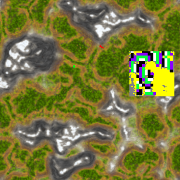
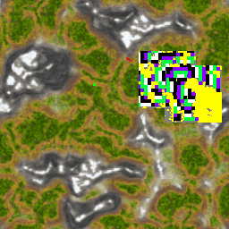
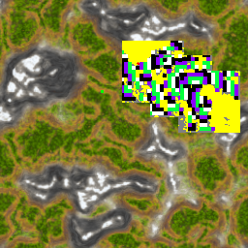
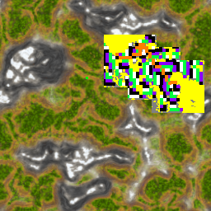
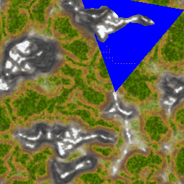
DEPICTIVE MANIPULATIONS (2 of 2)
Mark Path
Mark Obstacles
Distance Field Flood
Start-Layer 2
Obstacles
Layer 0-1
Layer 2-1
*
*
Steep Terrain
Layer 0-1
*
*
*
All Other
Layer 1-0
*
Layer 1-2
Layer 1-0
Takes specific shape of no-go terrain and obstacles (yellow) into account
Attention window shift controlled by Soar
Pixel rewrite rules sent from Soar to SVI
Determine approximate path coverage by overlaying each scout’s view frustum
Simulate alternate view orientations to determine “best” path coverage
Notes:
Transition: One of the goals for the architecture in this domain was to expand on how the agent manipulates the visual depictive representation.
Each individual rule is simple (similar to production rules in Soar) but when you put them all together they can produce complicated behavior and reasoning
In case someone asks…
Comparison with Cellular Automata
Similarities
Grid representation of states which change over time as a result of simple “rules”
Differences
Cellular Automata “rules” are implemented as Finite State Machines that change the state of each cell based on its current state and that of its neighbors.
Pixel-level rewrite rules rewrite local configurations of cells at once based on pattern matching the configuration and color
Makes it easier to work with patterns of varying granularity.
Been said that the Pixel rewrites are easier to program desired, rather than just “emergent,” functionality.
Comparison with Computer Vision (sentential-based algorithms)
- Computer vision uses pixel operations extensively in the early stages of preprocessing and parsing.
- Filters (e.g. Gaussian filters) highlight edges by enhancing brightness gradients in the pixel array.
- At later stages, computer vision parses shapes by tracing, pixel by pixel, the topologically connected components in the pixel array
- Most of the image processing operations are filters where each pixel is rewritten as a specific function of its neighbors’ values
- Pixel rewrites are sensitive to the pixel pattern in their local application so are less restrictive (the value of a pixel in that neighborhood changes not based on the value of its neighbors
but rather based on the RHS pattern).

Slide 10
RESULTS AMOUNT OF INFORMATION
Notes:
To illustrate, the Tracker scout team is an offline analysis where

Slide 11
SUMMARY
General reasoning with symbolic and perceptual-based representations where the reasoning emerges from the combination of the representations
Soar
Symbolic representations and computations
Goals and high-level knowledge
Controls imagery processing
Spatial and Visual Imagery (SVI)
Quantitative spatial and visual depictive representations and computations
Leverages perceptual mechanisms
Future Work - Push architecture closer to sensory input (Robotics)

