Slide 1

Soar One-hour Tutorial
John E. Laird
University of Michigan
March 2009
http://sitemaker.umich.edu/soar
laird@umich.edu
Supported in part by DARPA and ONR

Slide 2
Tutorial Outline
Cognitive Architecture
Soar History
Overview of Soar
Details of Basic Soar Processing and Syntax
  Internal decision cycle
  Interaction with external environments
  Subgoals and meta-reasoning
  Chunking
Recent extensions to Soar
  Reinforcement Learning
  Semantic Memory
  Episodic Memory
  Visual Imagery

Slide 3
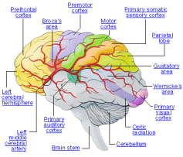
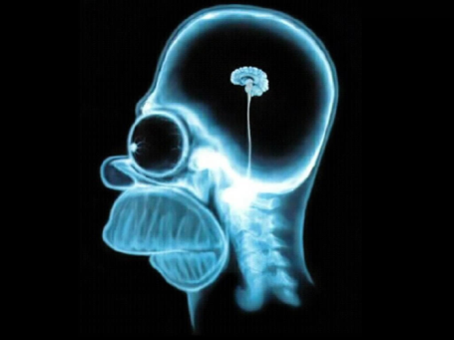
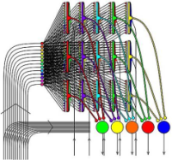
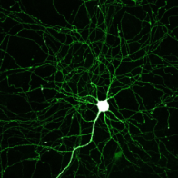
How can we build a human-level AI?
History
Talking on cell phone
Tasks
Calculus
Shopping
Sudoku
Reading
Driving
Learning
Brain Structure
Neural Circuits
Neurons
Notes:
Question of Levels – where do you start from?

Slide 4
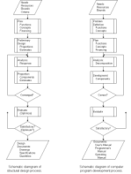
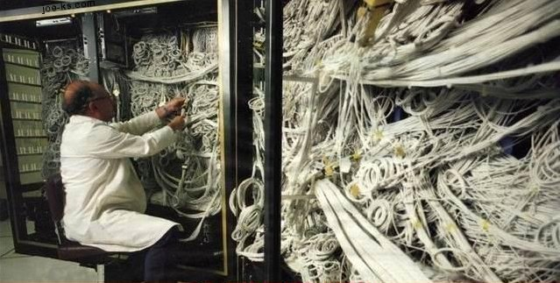
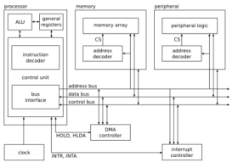
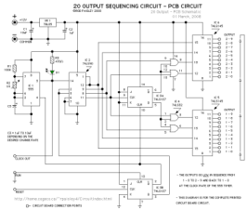
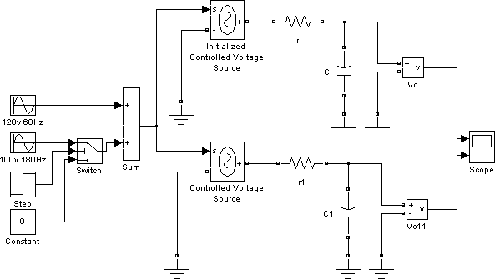
How can we build a human-level AI?
History
Talking on cell phone
Tasks
Calculus
Shopping
Programs
Sudoku
Reading
Driving
Learning
Brain Structure
Computer Architecture
Neural Circuits
Logic Circuits
Neurons
Electrical circuits
4
Notes:
Question of Levels – where do you start from?

Slide 5
How can we build a human-level AI?
History
Talking on cell phone
Tasks
Calculus
Shopping
Programs
Sudoku
Reading
Driving
Learning
Symbolic Long-Term Memories
Brain Structure
Procedural
Semantic
Episodic
Computer Architecture
Reinforcement
Learning
Chunking
Semantic
Learning
Episodic
Learning
Appraisals
Symbolic Short-Term Memory
Decision Procedure
Imagery
Perception
Action
Cognitive
Architecture
Neural Circuits
Logic Circuits
Neurons
Electrical circuits
5
Notes:
Question of Levels – where do you start from?

Slide 6
Cognitive Architecture
Knowledge
Goals
Fixed mechanisms underlying cognition
  Memories, processing elements, control, interfaces
  Representations of knowledge
  Separation of fixed processes and variable knowledge
  Complex behavior arises from composition of simple primitives
Purpose:
  Bring knowledge to bear to select actions to achieve goals
Not just a framework
  BDI, NN, logic & probability, rule-based systems
Important constraints:
  Continual performance
  Real-time performance
  Incremental, on-line learning
Architecture
Body
Task Environment
Notes:
Goal: instantly bring all available knowledge to bear to select actions to achieve goals.
Learning is implicit in “all relevant knowledge”
The perfect architecture:
Disappears so that only the task environment, knowledge, goals determine behavior.
Challenge is that architectures aren’t perfect
Large gap between competence and performance
Functional properties of the cognitive system that are determined by its structure (rather than by the instantaneous contents of its memory), properties such as the functional resources that the brain makes available (for example, which operations are primitive, how memory is organized and accessed, what sequences are allowed, what limitations exist on the passing of arguments and on the capacities of various buffers, and so on).

Slide 7
Common Structures of many
Cognitive Architectures
Declarative
Long-term Memory
Procedural
Long-term Memory
Declarative Learning
Procedure Learning
Short-term Memory
Goals
Action
Selection
Perception
Action
Notes:
The structure and organization of cognition
Fixed mechanisms and structures
Processors that manipulate data
Memories that hold knowledge
Interfaces that interact with an environment
Complex behavior arises from sequence of simple decisions over internal and external actions controlled by knowledge
Significant internal parallelism, limited external parallelism
For cognitive modeling, ~50msec is basic cycle time of cognition
Knowledge access must be bounded to maintain reactivity
Learning is incremental & on-line

Slide 8
Different Goals of
Cognitive Architecture
Biological plausibility: Does the architecture correspond to what we know about the brain?
Psychological plausibility: Does the architecture capture the details of human performance in a wide range of cognitive tasks?
Functionality: Does the architecture explain how humans achieve their high level of intellectual function?
  Building Human-level AI

Slide 9
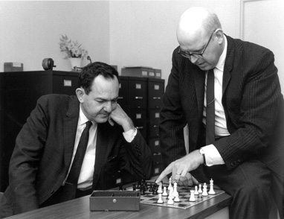
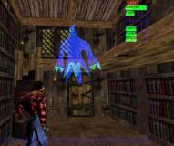

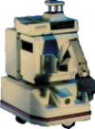
Short History of Soar
1980
1985
1990
1995
2000
2005
Modeling
Pre-Soar
Problem Spaces
Production Systems
Heuristic
Search
Multi-method
Multi-task problem solving
Subgoaling
Chunking
UTC
Natural Language
HCI
External Environment
Integration
Large bodies of knowledge
Teamwork
Real Application
Virtual Agents
Learning from Experience, Observation, Instruction
New Capabilities
Functionality
Notes:
Unusual AI project

Slide 10
Distinctive Features of Soar
Emphasis on functionality
  Take engineering, scaling issues seriously
  Interfaces to real world systems
  Can build very large systems in Soar that exist for a long time
Integration with perception and action
  Mental imagery and spatial reasoning
Integrates reaction, deliberation, meta-reasoning
  Dynamically switching between them
Integrated learning
  Chunking, reinforcement learning, episodic & semantic
Useful in cognitive modeling
  Expanding this is emphasis of many current projects
Easy to integrate with other systems & environments
  SML efficiently supports many languages, inter-process

Slide 11
System Architecture
Soar Kernel
Soar 9.0 Kernel (C)
gSKI
Higher-level Interface (C++)
KernelSML
Encodes/Decodes function calls and responses in XML (C++)
SML
Soar Markup Language
ClientSML
Encodes/Decodes function calls and responses in XML (C++)
SWIG Language
Layer
Wrapper for Java/Tcl (Not needed if app is in C++)
Application
Application (any language)

Slide 12
Soar Basics
Operator
?
?
Agent in real or virtual world
Agent in new state
Agent in new state
Operators: Deliberate changes to internal/external state
Activity is a series of operators controlled by knowledge:
  Input from environment
  Elaborate current situation: parallel rules
  Propose and evaluate operators via preferences: parallel rules
  Select operator
  Apply operator: Modify internal data structures: parallel rules
  Output to motor system
Notes:
Operator = deliberate act
Generally two rules for each operator
No set methods – methods arise from either task dependent knowledge or general indirect strategies

Slide 13
Basic Soar Architecture
Long-Term Memory
Procedural
Chunking
Symbolic Short-Term Memory
Decision Procedure
Perception
Action
Body
Select Operator
Apply Operator
Elaborate State
Input
Propose Operators
Decide
Elaborate
Operator
Apply
Output
Evaluate Operators

Slide 14
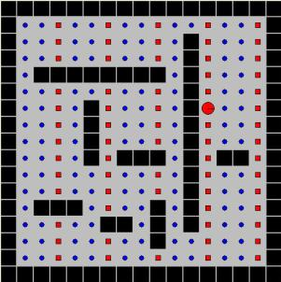
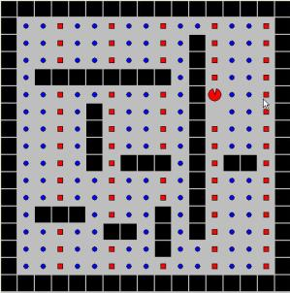
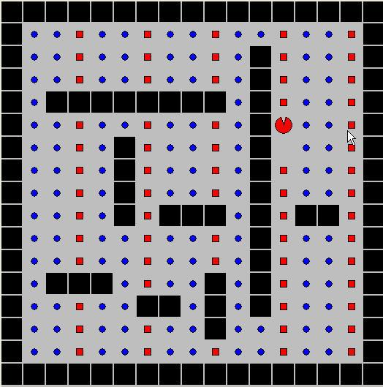


Soar 101: Eaters
Input
Propose
Operator
Input
Propose
Operator
Evaluate
Operators
Apply
Operator
Output
Evaluate
Operators
Select
Operator
Apply
Operator
Output
Select
Operator
If operator <o1> will move to a empty cell
-->
operator <o1> <
If cell in direction <d> is not a wall,
-->
propose operator
move <d>
If operator <o1> will move to a bonus food and operator <o2> will move to a normal food,
-->
operator <o1> > <o2>
If an operator is selected to move <d>
-->
create output
move-direction <d>
Production
Memory
East
North
move-direction North
South
North > East
South <
North > East
South > East
North = South
Working
Memory

Slide 15
Example Working Memory
A
(s1 ^block b1 ^block b2 ^table t1)
(b1 ^color blue ^name A ^ontop b2 ^size 1
^type block ^weight 14)
(b2 ^color yellow ^name B ^ontop t1 ^size 1
^type block ^under b1 ^weight 14)
(t1 ^color gray ^shape square
^type table ^under b2)
B
b1
yellow
^block
^color
^under
^name
B
S1
^block
b2
^size
1
^type
^ontop
block
^table
^weight
t1
14
Working memory is a graph.
All working memory elements must be “linked” directly or indirectly to a state.

Slide 16
Soar Processing Cycle
Select Operator
Apply Operator
Elaborate State
Input
Propose Operators
Decide
Elaborate
Operator
Apply
Output
Evaluate Operators
Rules
Impasse
Subgoal
Select Operator
Apply Operator
Elaborate State
Elaborate
Operator
Input
Propose Operators
Decide
Apply
Output
Evaluate Operators

Slide 17
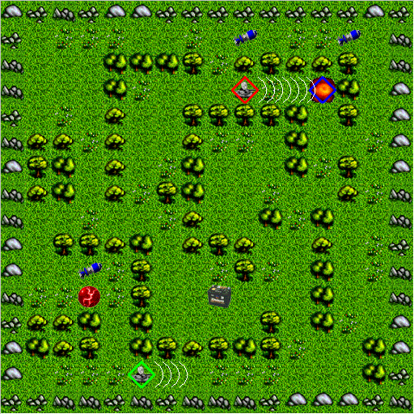
TankSoar
Red Tank’s Shield
Borders (stone)
Walls (trees)
Health charger
Missile pack
Blue tank (Ouch!)
Energy charger
Green tank’s radar

Slide 18
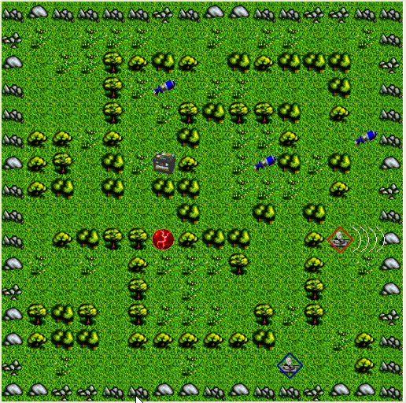
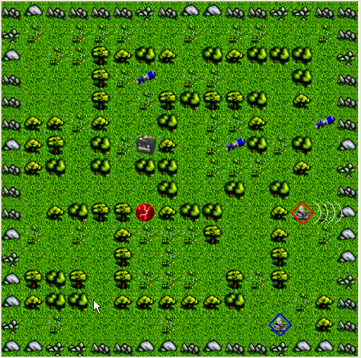
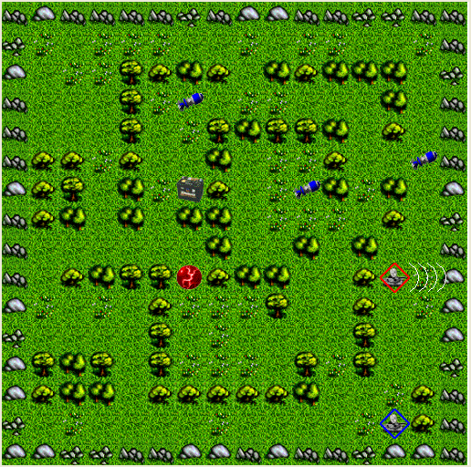
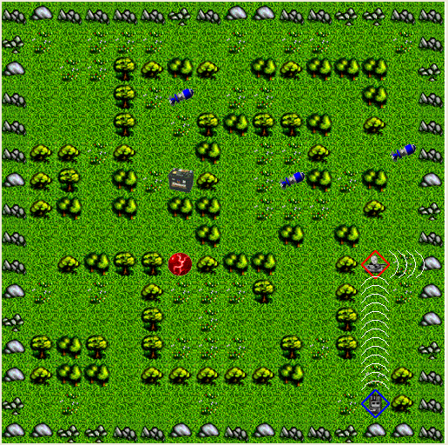
Soar 103: Subgoals
Input
Input
Select
Operator
Select
Operator
Output
Propose
Operator
Output
Propose
Operator
Compare
Operators
Compare
Operators
Apply
Operator
Apply
Operator
If enemy not sensed, then wander
Wander
Move
Turn

Slide 19
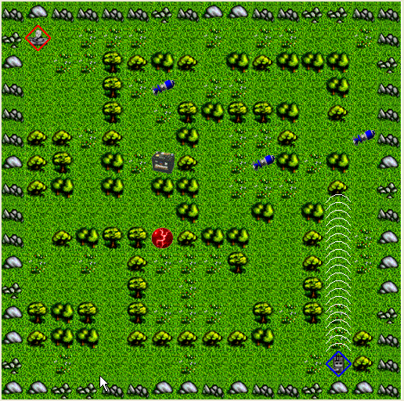
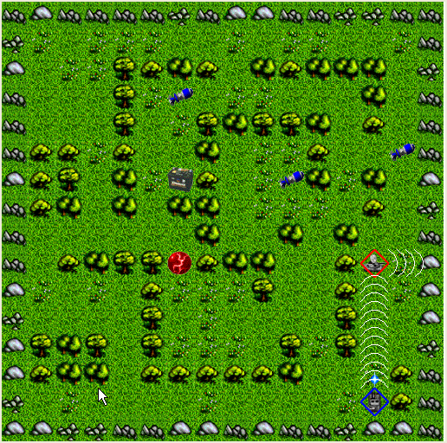
Soar 103: Subgoals
Input
Propose
Operator
Compare
Operators
Select
Operator
Apply
Operator
Output
If enemy is sensed, then attack
Attack
Shoot

Slide 20
TacAir-Soar [1997]
Controls simulated aircraft in real-time training exercises (>3000 entities)
Flies all U.S. air missions
Dynamically changes missions as appropriate
Communicates and coordinates with computer and human controlled planes
Large knowledge base
(8000 rules)
No learning

Slide 21
TacAir-Soar Task Decomposition
Execute
Mission
If instructed to intercept an enemy then
propose intercept
If intercepting an enemy and
the enemy is within range
ROE are met then
propose employ-weapons
Intercept
Fly-Wing
Intercept
Fly-route
Ground
Attack
If employing-weapons and
missile has been selected and
the enemy is in the steering circle and LAR has been achieved,
then propose launch-missile
Achieve
Proximity
Employ
Weapons
Employ
Weapons
Search
Scram
Execute
Tactic
Get Missile
LAR
Select
Missile
Launch
Missile
Launch
Missile
Get Steering
Circle
Sort
Group
If launching a missile and
it is an IR missile and
there is currently no IR lock
then propose lock-IR
Lock Radar
Lock IR
Lock IR
Fire-Missile
Wait-for
Missile-Clear
>250 goals, >600 operators, >8000 rules
Notes:
Can be selected at any level in the goal hierarchy
Support innate goals:
Survive, maintain situational awareness
Turn to avoid possible enemy
Adjust radar to maintain situational awareness on bogey
Communicate a bogey sighting
Detect that a bogey has performed some action

Slide 22
Impasse/Substate Implications:
Substate is really meta-state that allows system to reflect
Substate = goal to resolve impasse
  Generate operator
  Select operator (deliberate control)
  Apply operator (task decomposition)
All basic problem solving functions open to reflection
  Operator creation, selection, application, state elaboration
Substate is where knowledge to resolve impasse can be found
Hierarchy of substate/subgoals arise through recursive impasses

Slide 23
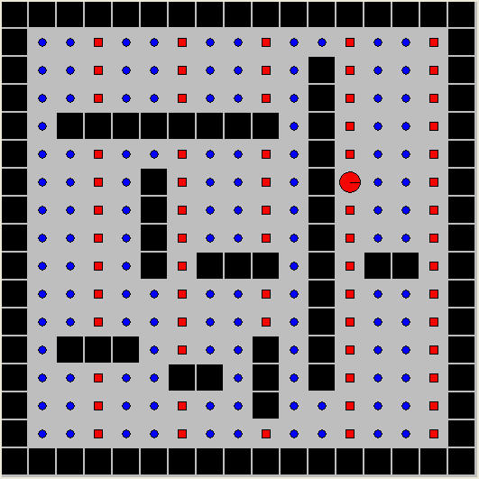
Tie Subgoals and Chunking
Input
Input
Propose
Operator
Output
Propose
Operator
Evaluate
Operators
Select
Operator
Apply
Operator
Evaluate
Operators
Select
Operator
Tie Impasse
North > East
South > East
North = South
Chunking creates
rules that create preferences based on what was tested
East
North
South
Evaluate-operator
(North)
Evaluate-operator
(South)
Evaluate-operator
(East)
= 10
= 10
= 5
= 10
Chunking creates
rule that applies
evaluate-operator
North
= 10

Slide 24
Chunking Analysis
Converts deliberate reasoning/planning to reaction
Generality of learning based on generality of reasoning
  Leads to many different types learning
  If reasoning is inductive, so is learning
Soar only learns what it thinks about
Chunking is impasse driven
  Learning arises from a lack of knowledge

Slide 25
Extending Soar
Learn from internal rewards
  Reinforcement learning
Learn facts
  What you know
  Semantic memory
Learn events
  What you remember
  Episodic memory
Basic drives and …
  Emotions, feelings, mood
Non-symbolic reasoning
  Mental imagery
Learn from regularities
  Spatial and temporal clusters
Symbolic Long-Term Memories
Procedural
Episodic
Semantic
Episodic
Semantic
Reinforcement
Learning
Reinforcement
Learning
Chunking
Semantic
Learning
Episodic
Learning
Semantic
Learning
Episodic
Learning
Symbolic Short-Term Memory
Appraisal Detector
Appraisal Detector
Decision Procedure
Clustering
Clustering
Visual
Imagery
Visual
Imagery
Perception
Action
Body

Slide 26
Theoretical Commitments
Stayed the Same
Changed
Problem Space Computational Model
Long-term & short-term memories
Associative procedural knowledge
Fixed decision procedure
Impasse-driven reasoning
Incremental, experience-driven learning
No task-specific modules
Multiple long-term memories
Multiple learning mechanisms
Modality-specific representations & processing
Non-symbolic processing
  Symbol generation (clustering)
  Control (numeric preferences)
  Learning Control (reinforcement learning)
  Intrinsic reward (appraisals)
  Aid memory retrieval (WM activation)
  Non-symbolic reasoning (visual imagery)

Slide 27
Reinforcement Learning
Shelly Nason

Slide 28
RL in Soar
Encode the value function as operator evaluation rules with numeric preferences.
Combine all numeric preferences for an operator dynamically.
Adjust value of numeric preferences with experience.
Reward
Internal State
Perception
Update Value
Function
Value Function
Action Selection
Action

Slide 29
The Q-function in Soar
The value-function is stored in rules that test the state and operator, and create numeric preferences.
sp {rl-rule
(state <s> ^operator <o> +)
…
-->
(<s> ^operator <o> = 0.34)}
Operator Q-value = the sum of all numeric preferences.
Selection: epsilon greedy, or Boltzmann
O1: {.34, .45, .02} = 8.1
epsilon-greedy: With probability ε the agent selects an action at random. Otherwise the agent takes the action with the highest expected value.
[Balance exploration/exploitation]
O2: {.25, .11, .12} = 4.8
O3: {-.04, .14, -.05} = .05

Slide 30
Updating operator values
r = reward = .2
R1(O1) = .20
R2(O1) = .15
R3(O1)= -.02
O1 = .33
O2 = .11
Q(s,O1) = sum of numeric prefs.
Q(s’,O2) = sum of numeric prefs. of selected operator (O2)
Sarsa update:
Q(s,O1) ← Q(s,O1) + α[r + λQ(s’,O2) – Q(s,O1)]
.1 * [.2 + .9*.11 - .33] = -.03
Update is split evenly between rules contributing to O1 = -.01.
R1 = .19, R2 = .14, R3 = -.03

Slide 31
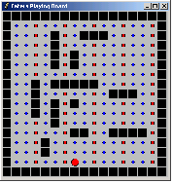
Results with Eaters

Slide 32
RL TankSoar Agent

Slide 33
Semantic Memory
Yongjia Wang

Slide 34
Memory Systems
Memory
Long Term Memory
Short Term Memory
Declarative
Procedural
Perceptual Representation System
Procedural Memory
Working Memory
Semantic Memory
Episodic Memory
Notes:
Bring up declarative representation and procedural representation.
Declarative representation: computationally, it means representation (in any language) that can be used to make inference or reasoning.

Slide 35
Declarative Memory Alternatives
Working Memory
  Keep everything in working memory
Retrieve dynamically with rules
  Rules provide asymmetric access
  Data chunking to learn (complex)
Separate Declarative Memories
  Semantic memory (facts)
  Episodic memory (events)
Notes:
Short-term, declarative representation and rules are required for the system to run.
SOAR doesn’t save the long-term storage for WMEs, instead, SOAR proceduralizes the retrieval of the necessary declarative knowledge, and save them in the form of production rules. The single procedural knowledge representation works quite well to encode initial knowledge, declarative or procedurally. But it has problem to learn new declarative knowledge. Chunking is not the way to do that.
Data learning is a major discovery in Soar, and is believed to demonstrate some limitations of procedural representation and chunking.
The general idea is that regular chunking cannot learn desired associational rules (proceduralized declarative knowledge retrieval) , and must use some tricks to do that, which is rather cumbersome.
To have long-term declarative memory will solve the problem straight-forwardly.
For more detail about data learning problem itself, refer to the paper, which also compared SOAR and ACT-R
Currently we are extending SOAR architecture by integrating architectural declarative memories.
To have some general idea,
Soar semantic memory would be equivalent to ACT-R declarative memory.
Soar episodic memory will touch on some different aspects beyond that.

Slide 36
Basic Semantic Memory Functionalities
Encoding
  What to save?
  When to add new declarative chunk?
  How to update knowledge?
Retrieval
  How the cue is placed and matched?
  What are the different types of retrieval?
Storage
  What are the storage structures?
  How are they maintained?
Notes:
Here are the decomposed functionalities of semantic memory. We’ll look at each of those questions in more detail.
Those questions, in nature, are heavily interrelated and constrained with each other.
Some questions are relatively easier to commit, some are rather open issues.

Slide 37
Semantic Memory Functionalities
AutoCommit
state
Working Memory
Feature Match
Semantic Memory
B
A
A
Retrieval
C
Cue
Expand
Save
Cue
NIL
NIL
Save
NIL
D
E
E
F
Expand
B
A
Save
Update with Complex Structure
E
D
F
E
Remove-No-Change
Notes:
Other WME dynamics still kept the same.
I-supported WMEs will retract for every cycle.
For O-supported WMEs, they will persist. And probably automatically cleared from WM when the activation decayed below some level.
The theory is that New knowledge is integrated into the knowledge base by connecting with other existing knowledge, and the terminal leaf values (constants) are all considered part of the initial starting knowledge.

Slide 38

Episodic Memory
Andrew Nuxoll
Notes:
anterograde amnesia,

Slide 39
Memory Systems
Memory
Long Term Memory
Short Term Memory
Declarative
Procedural
Perceptual Representation System
Procedural Memory
Working Memory
Semantic Memory
Episodic Memory
Notes:
Bring up declarative representation and procedural representation.
Declarative representation: computationally, it means representation (in any language) that can be used to make inference or reasoning.

Slide 40
Episodic vs. Semantic Memory
Semantic Memory
  Knowledge of what we “know”
  Example: what state the Grand Canyon is in
Episodic Memory
  History of specific events
  Example: a family vacation to the
  Grand Canyon
Notes:
Episodic memory is your personal history. It’s a personal history of specific events from our past, like your last family vacation to the Grand Canyon. Perhaps the best way to understand episodic memory is to contrast it with semantic memory, which is knowledge of what we know. You may know that the Grand Canyon is in Arizona but you probably can not point out a specific event or events in your past where you gained that knowledge.

Slide 41
Characteristics of Episodic Memory: Tulving
Architectural:
  Does not compete with reasoning.
  Task independent
Automatic:
  Memories created without deliberate decision.
Autonoetic:
  Retrieved memory is distinguished from sensing.
Autobiographical:
  Episode remembered from own perspective.
Variable Duration:
  The time period spanned by a memory is not fixed.
Temporally Indexed:
  Rememberer has a sense of when the episode occurred.
Notes:
No exactly a blueprint for designing and implementing, but gives important functional characteristics
Contrast with CBR

Slide 42
Implementation
Long-term Procedural Memory
Production Rules
Encoding
Initiation?
Storage
Retrieval
Output
Working Memory
Cue
Input
Retrieved
When the agent takes an action.

Slide 43
Current Implementation
Long-term Procedural Memory
Production Rules
Encoding
Initiation
Content?
Storage
Retrieval
Output
Working Memory
Cue
Input
Retrieved
The entire working memory is stored in the episode

Slide 44
Current Implementation
Long-term Procedural Memory
Production Rules
Episodic
Memory
Encoding
Initiation
Content
Storage
Episode Structure?
Retrieval
Output
Working Memory
Cue
Episodic
Learning
Input
Retrieved
Episodes are stored in a separate memory

Slide 45
Current Implementation
Long-term Procedural Memory
Production Rules
Episodic
Memory
Encoding
Initiation
Content
Storage
Episode Structure
Retrieval
Initiation/Cue?
Output
Working Memory
Cue
Episodic
Learning
Input
Retrieved
Cue is placed in an architecture specific buffer.

Slide 46
Current Implementation
Long-term Procedural Memory
Production Rules
Episodic
Memory
Encoding
Initiation
Content
Storage
Episode Structure
Retrieval
Initiation/Cue
Retrieval
Output
Working Memory
Cue
Episodic
Learning
Input
Retrieved
The closest partial match is retrieved.

Slide 47
Cognitive Capability: Virtual Sensing
Retrieve prior perception that is relevant to the current task
Tank recursively searches memory
  Have I seen a charger from here?
  Have I seen a place where I can see a charger?
?
Notes:
Finding way to friend’s house is Virtual sensing example

Slide 48
Virtual Sensors Results

Slide 49
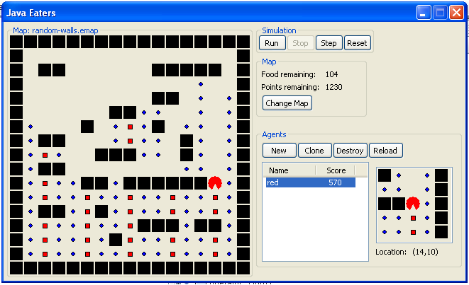


Cognitive Capability: Action Modeling
Agent attempts to choose direction
Agent’s knowledge is insufficient - impasse
Evaluate moving in each available direction
Create a memory cue
Retrieve the best matching memory
Retrieve the next memory
Use the change in score to evaluate the proposed action
East
North
Move North = 10 points
South
Episodic
Retrieval
Retrieve
Next Memory
Notes:
Define action modeling

Slide 50
Episodic Memory:
Multi-Step Action Projection
[Andrew Nuxoll]
Learn tactics from prior success and failure
  Fight/flight
  Back away from enemy (and fire)
  Dodging
Notes:
Demis Hassabis *, Dharshan Kumaran *, Seralynne D. Vann , and Eleanor A. Maguire * *Wellcome Trust Centre for Neuroimaging, Institute of Neurology, University College London, 12 Queen Square, London WC1N 3BG, United Kingdom; and School of Psychology, Cardiff University, Tower Building, Park Place, Cardiff CF10 3AT, United Kingdom
Communicated by Endel Tulving, Rotman Research Institute of Baycrest Centre, North York, ON, Canada, November 29, 2006 (received for review October 11, 2006)
Amnesic patients have a well established deficit in remembering their past experiences. Surprisingly, however, the question as to whether such patients can imagine new experiences has not been formally addressed to our knowledge. We tested whether a group of amnesic patients with primary damage to the hippocampus bilaterally could construct new imagined experiences in response to short verbal cues that outlined a range of simple commonplace scenarios. Our results revealed that patients were markedly impaired relative to matched control subjects at imagining new experiences. Moreover, we identified a possible source for this deficit. The patients' imagined experiences lacked spatial coherence, consisting instead of fragmented images in the absence of a holistic representation of the environmental setting. The hippocampus, therefore, may make a critical contribution to the creation of new experiences by providing the spatial context into which the disparate elements of an experience can be bound. Given how closely imagined experiences match episodic memories, the absence of this function mediated by the hippocampus, may also fundamentally affect the ability to vividly re-experience the past.

Slide 51
Enables Cognitive Capabilities
Episodic Memory
Sensing
  Detect Changes
  Detect Repetition
  Virtual Sensing
Reasoning
  Model Actions
  Use Previous Successes/Failures
  Model the Environment
  Manage Long Term Goals
  Explain Behavior
Learning
  Retroactive Learning
  Allows Reanalysis Given New Knowledge
  “Boost” other Learning Mechanisms

Slide 52
Mental Imagery and Spatial Reasoning
Scott Lathrop
Sam Wintermute
See AGI Talks

Slide 53
WHAT IS VISUAL IMAGERY?
VISUAL IMAGERY
VISUAL-SPATIAL
VISUAL-DEPICTIVE
Location, orientation
Sentential, quantitative representations
Linear algebra and computational geometry algorithms
Shape, color, topology, spatial properties
Depictive, pixel-based representations
Image algebra algorithms
  Sentential/Algebraic algorithms
  Depictive/Ordinal algorithms
Notes:
Transition: These two questions illustrate the two types of visual imagery. The first example uses the visual-spatial form of imagery, the second example requires a depictive representation to infer the spatial property of width.
(be careful what you say). Clarify that this is the functional and computational mechanisms you are using and not what people necessarily use.
Depictive representations/algorithms – takes advantage of topological (rather than geometrical) relationships. Take advantage of neighboring relationships between pixels.

Slide 54
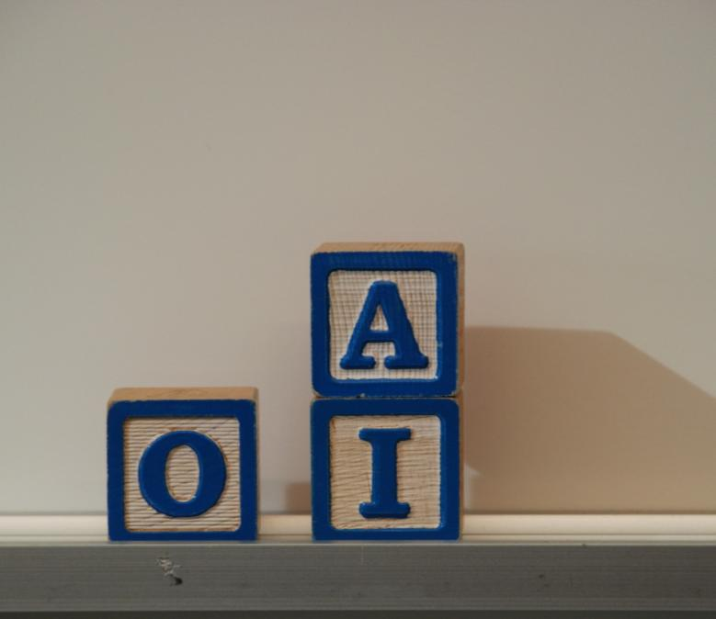
Where can you put A next to I?

Slide 55
Spatial Problem Solving with Mental Imagery
[Scott Lathrop & Sam Wintermute]
(on AI)
(intersect A′ O)
(no_intersect A’)
(imagine_left_of A I)
(imagine_right_of A I)
Soar
(move_right_of A I)
Qualitative descriptions of object relationships
Qualitative description of new objects in relation to existing objects
A
O
A’
I
A’
Spatial Scene
Quantitative descriptions of environmental objects
Environment

Slide 56
Upcoming Challenges
Continued refinement and integration
Integrate with complex perception and motor systems
Adding/learning lots of world knowledge
  Language, Spatial, Temporal Reasoning, …
Scaling up to large bodies of knowledge
  Build up from instruction, experience, exploration, …

Slide 57
Soar Community
Soar Website
  http://sitemaker.umich.edu/soar
Soar Workshop every June in Ann Arbor
  June 22-26, 2009
Soar-group
  http://lists.sourceforge.net/lists/listinfo/soar-group
  Low traffic

Slide 58
Thanks to
Funding Agencies:
NSF, DARPA, ONR
Ph.D. students:
Nate Derbinsky, Nicholas Gorski, Scott Lathrop, Robert Marinier, Andrew Nuxoll, Yongjia Wang, Samuel Wintermute, Joseph Xu
Research Programmers:
Karen Coulter, Jonathan Voigt
Continued inspiration:
Allen Newell

Slide 59
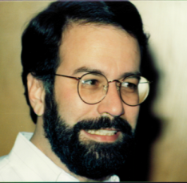























Slide 60
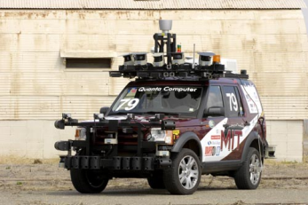
Challenges in
Cognitive Architecture Research
Dynamic taskability
  Pursue novel tasks
Learning
  Always learning, learning in unexpected and unplanned ways (wild learning)
  Transition from programming to learning by imitation, instruction, experience, reflection, …
Natural language
  Active area but much left to do.
Social behavior
  Interaction with humans and other entities
Connect to the real world
  Cognitive robotics with long-term existence
Applications
  Expand domains and problems
  Putting cognitive architectures to work
Connect to unfolding research on the brain, psychology, and the rest of AI.

Slide 61
ACT-R
The ‘chunk’ declarative data structure
Buffers holding single chunk
Long term declarative memory
visualization
goal
declarative memory
#3
perception
#45
#45
red #3 ‘x’ #9
Notes:
We’ll first briefly go through another cognitive architecture ACT-R to see how ACT-R works.
I believe this will help understand the related issues to be discussed later.
ACT-R ‘chunk’ is the declarative representation, which has an array of slot-value pairs.
The value of a slot could be the chunk-name of some other chunk, therefore form a semantic network by the connections.
There are specialized buffers each holding a single chunk. Buffers serve for the same functionalities as SOAR working memory.
Production rules can test buffers and fire to have actions on buffers.
There are long-term declarative memory to save the chunks when they are cleared from the buffer.
SOAR semantic memory just corresponds to the ACT-R declarative memory.

Slide 62
Relevant Soar - ACT-R Differences
Soar
  Single generic Working Memory
  WME structures represent individual attributes
  Activations associated with individual attributes
  Complex WM structures, parallel/serial rule firing
ACT-R
  Specialized buffers
  Chunk is the atomic retrieval unit
  Activations associated with chunks
  Each buffer holds single chunk, serial rule firing
Notes:
Everything seems so simple so far, but there are these related differences between ACT-R and SOAR that will also make differences in semantic memory.
These are long standing architectural differences that are expected to keep existing for ‘quite a while’.
In general,
ACT-R makes more theoretic commitments about working memory. Soar makes minimal commitments.
The unrestricted form of WM structure allows Soar to take advantage parallel rule firing. Operator is the mechanism to enforce required serializations.
One advantage of individual attribute associated activation is to provide a domain-independent way to determine weights of features, which has already been tested in Episodic memory implementation.

